Slide 1



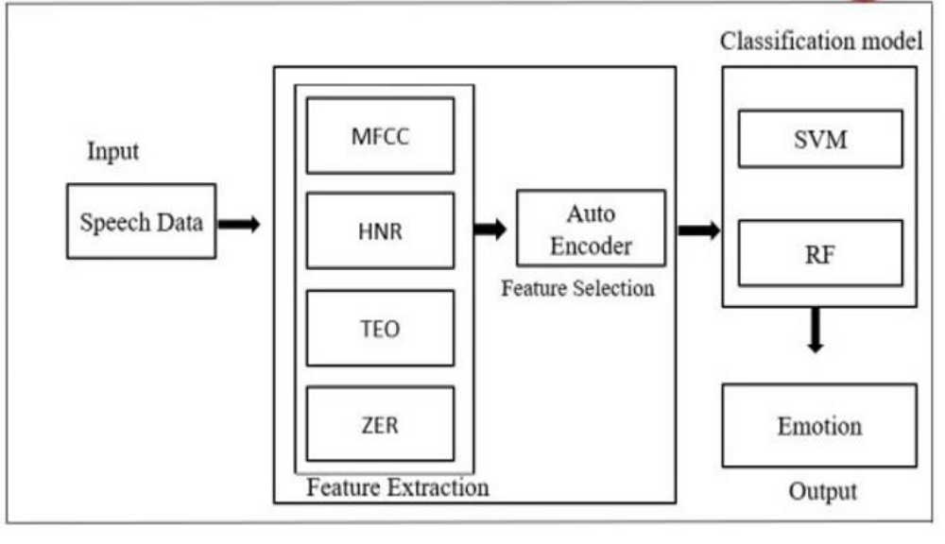
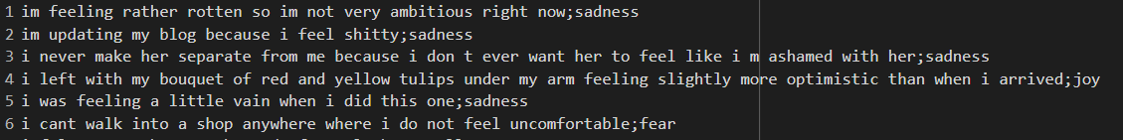
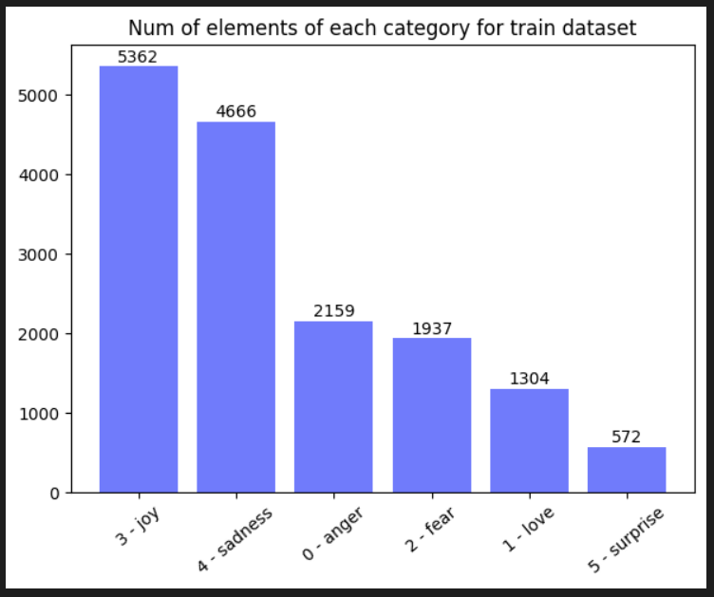
ENHANCED EMOTIONAL SPEECH ANALYSIS
Department of Computer Science & Engineering
School of Computing
10214CS602 – MINOR PROJECT-II
WINTER SEMESTER 2023-2024
ABSTRACT
INTRODUCTION
RESULTS
STANDARDS AND POLICIES
The Emotion Classification Web Application, developed using Python and the Flask framework, serves as an intuitive platform for users to analyze and classify emotions expressed within textual input. Leveraging a sophisticated deep learning model trained on a comprehensive dataset comprising diverse text samples annotated with various emotions, the application offers a robust solution for emotion classification tasks. Through a user-friendly web interface, individuals can effortlessly input text for analysis, initiating a seamless process of emotion prediction. Prior to classification, the input text undergoes a series of preprocessing steps, including tokenization and the removal of stopwords ensuring optimal data preparation for accurate emotion assessment. Subsequently, the preprocessed text is fed into the pre-trained deep learning model, which employs advanced algorithms to predict the predominant emotions conveyed within the input text. The predicted emotions are then elegantly displayed to the user via the web interface, providing valuable insights into the emotional nuances encapsulated within the text. With its intuitive design and streamlined functionality, the application facilitates seamless interaction, empowering users to gain deeper insights into the emotional context of their textual input. Whether used for personal reflection, sentiment analysis or emotional intelligence enhancement.
In today's digital era, where textual communication reigns supreme across various online platforms, understanding the underlying emotions conveyed through text has become increasingly important. The Emotion Classification Web Application emerges as a pioneering project poised to address this need by providing users with a sophisticated tool for analyzing and categorizing emotions expressed in textual data. Through the seamless integration of cutting-edge deep learning techniques and a user-friendly web interface, this project offers a novel solution to the age-old challenge of interpreting emotions in written communication. With its potential applications spanning diverse domains such as social media sentiment analysis, customer feedback evaluation, and mental health assessment, the Emotion Classification Web Application holds promise as a transformative tool for unlocking insights into human emotions in the digital realm.
At the heart of the Emotion Classification Web Application lies a powerful deep learning model trained on vast datasets of annotated text samples encompassing a wide range of emotions. This state-of-the-art model, powered by advanced natural language processing algorithms, excels at deciphering the subtle nuances of human expression encoded within textual data. By leveraging techniques such as tokenization, stopwords removal, and bidirectional LSTM networks, the application achieves unparalleled accuracy in emotion classification tasks. Additionally, the integration of pre-trained word embeddings further enhances the model's ability to capture semantic relationships and contextual information, enabling precise and nuanced emotion predictions with each input.
Emotion Classification Accuracy: Measure the accuracy of the trained model in correctly predicting the emotions associated with text samples in the test dataset. This metric indicates the effectiveness of the model in classifying emotions.
Confusion Matrix: Analyze the confusion matrix to understand the distribution of predicted emotions compared to the true labels. This helps identify any specific emotions that the model struggles to classify accurately.
Precision, Recall, and F1-score: Calculate precision, recall, and F1-score for each emotion class to evaluate the model's performance in terms of precision (the proportion of correctly predicted positive cases among all predicted positive cases), recall (the proportion of correctly predicted positive cases among all actual positive cases), and F1-score (the harmonic mean of precision and recall).
Python Standard Used: PEP 257
Flask Framework Standard Used: PEP 8 (Style Guide for Python Code)
Table 1. Text dataset
Figure 1. Architecture Diagram
METHODOLOGIES
CONCLUSIONS
Data Collection: Gather datasets containing text samples annotated with emotions.
Data Preprocessing: Clean and preprocess the text data by removing noise, such as special characters and punctuation, converting text to lowercase, tokenizing sentences into words, and removing stopwords.
Word Embedding: Utilize pre-trained word embeddings, such as Word2Vec or FastText, to represent words as dense vectors in a continuous vector space.
Model Development: Design and implement a deep learning model for emotion classification, typically involving a neural network architecture with embedding layers, bidirectional LSTM layers, dropout layers for regularization, and a dense output layer with softmax activation for multi-class classification.
Model Training: Train the emotion classification model on the preprocessed training data using appropriate loss functions, optimizers, and evaluation metrics.
Model Evaluation: Evaluate the trained model's performance on the test dataset to assess its ability to generalize to unseen data, calculating metrics such as accuracy, precision, recall, and F1-score.
The development of a real-time network threat detection system represents a pivotal step towards enhancing cyber security measures in modern IT infrastructures. Through the integration of machine learning algorithms and Open Source Intelligence threat feeds the project has successfully demonstrated the efficacy of leveraging advanced technologies to monitor, detect, and respond to security incidents effectively. The project's emphasis on automation and self-learning mechanisms contributes to reducing maintenance complexity and enhancing system resilience.
TEAM MEMBER DETAILS
VTU19524 / B. KRISHNA SAI
+91 7207808048
krishnasaibobba99@gmail.com
VTU20607 / P. SANJANA
+91 7396329236
vtu20607@veltech.edu.in
VTU19528 / A. MANI SAI RISHIK
+91 7780740451
vtu19827@veltech.edu.in
ACKNOWLEDGEMENT
Supervisor Name: Dr. T. B. SIVAKUMAR / ASSOCIATE PROFESSOR
Supervisor Number: +91 9791875843
Supervisor E-mail: sivakumar@veltech.edu.in
Chart 1. Types of Emotions

